Slide 1
Satish Pradhan Dnyanasadhana College
Project Title:
ORGAN DONATION APP
Academic year: (2020-2021)

Slide 2
Problem Statement:-
India has only 301 hospitals that can perform organ transplantation which means there exist only one hospital equipped for organ transplantation and retrieval for around 43 lakh people, But lack of infrastructure is only one of the issues hampering organ donation in India.The demand for organ transplantation has rapidly increased all over the world during the past decade due to the increased incidence of vital organ failure, the rising success and greater improvement in posttransplant outcome.

Slide 3
Abstract :-
The need for organs for donation is far greater than organ availability. In the last decade this has led to restructuring and investment in the organ donation programme with political and public support.
Organ Donation in India has always been on a lower side and around 5 lakh people die every year in India due to unavailability of organs. Nearly 2.2 lakh people await kidney transplant, of which around 15,000 end up receiving a kidney. At a given point of time, about 1 lakh people die of liver diseases in India and only 1,000 get liver transplant.
A death or death donor can save up to 8 lives, but despite this organ donation is a neglected issue.
Lack of knowledge, awareness, infrastructure are some of the reasons behind shortage of organ donation in India.

Slide 4
Introduction of system :-
This android application will help user to get organ from donor. This system has two entities namely, Admin and User.
Admin can login using credentials. admin can view all Doctors and they can add, update and delete Doctors. admin can view and assign Doctor, Donor to the recipient.
User can register and login using credentials. If they forget password, send an email with reset Password. User can also check the assigned doctor and donor via SMS. They can view doctors list. They will also get notification of their chats.

Slide 5
Observation :-
To evaluate current possibilities that transplantation to the patients.
To propose alternatives to modify this medical and social crisis.
To provide a better facility to medical field.
Encourage people to talk to others about the importance of organ donation.
To educate the people about organ donation.

Slide 6
Module Explanation :-
User :-
Register: User can register and obtain credentials.
Login: User can login using credentials.
Home: There will be three slots Recipient, Donor and Contact.
Recipient: User can manage request by adding and updating request.
Donor: User can add details.
Notification: Notification on Admin Assigning doctors and donors to the Request.
2. Admin :-
Login: Admin can login using credentials.
Manage Doctors: Admin can view all Doctors.
View Organ Request: Admin can view request of recipient.
View Donor List: Admin can view list of donations.
View Users List: Admin can view user list.
Assigned Recipient: Admin can assign doctor, donor to the recipient.

Slide 7
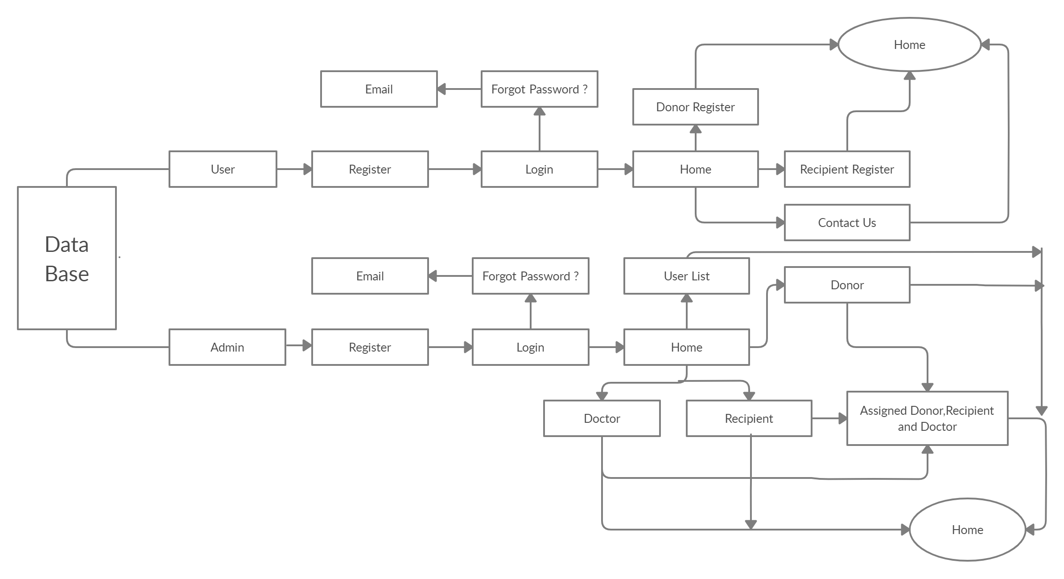
Block Diagram :-

Slide 8
Advantages :-
The proposed system will save significant amount of time and effort.
The System fully works as an online.
This system is user friendly.
Doctor and User can directly connect to each other.
Disadvantages :-
Evaluate to match the process large amount of data.
Data need to be entered properly otherwise,
outcome may won’t be accurate.

Slide 9
Hardware Requirement :-
Laptop or PC :-
i3 Processor Based Computer or higher
4GB RAM
1 TB Hard Disk
Android Phone or Tablet :-
1.2 Quad core Processor or higher GB RAM
Software Requirement :-
Laptop or PC :-
Windows 7 or higher.
Frontend :- Android Studio
Backend :- Database(Firebase)
Android Phone/Tablet :-
Android v5.0 or Higher

Slide 10
Future Scope :-
The Organ Donation App is Android based application which will be helpful for Donate and Receive organs.
Location Services will improve in future.
Selection and Assigned Recipient improve in future.

Slide 11
Conclusion :-
Organ donation can save a person’s life.
A proper application should be put in place for organ donation to encourage the same. Most of the countries around the world suffer from low organ donor rate.
The issue must be taken more seriously. Laws to increase the rate of organ donation must be put in place to encourage the same.

Slide 12
Thank You!!!

